Slide 1
Image Segmentation
U-Net

Slide 2
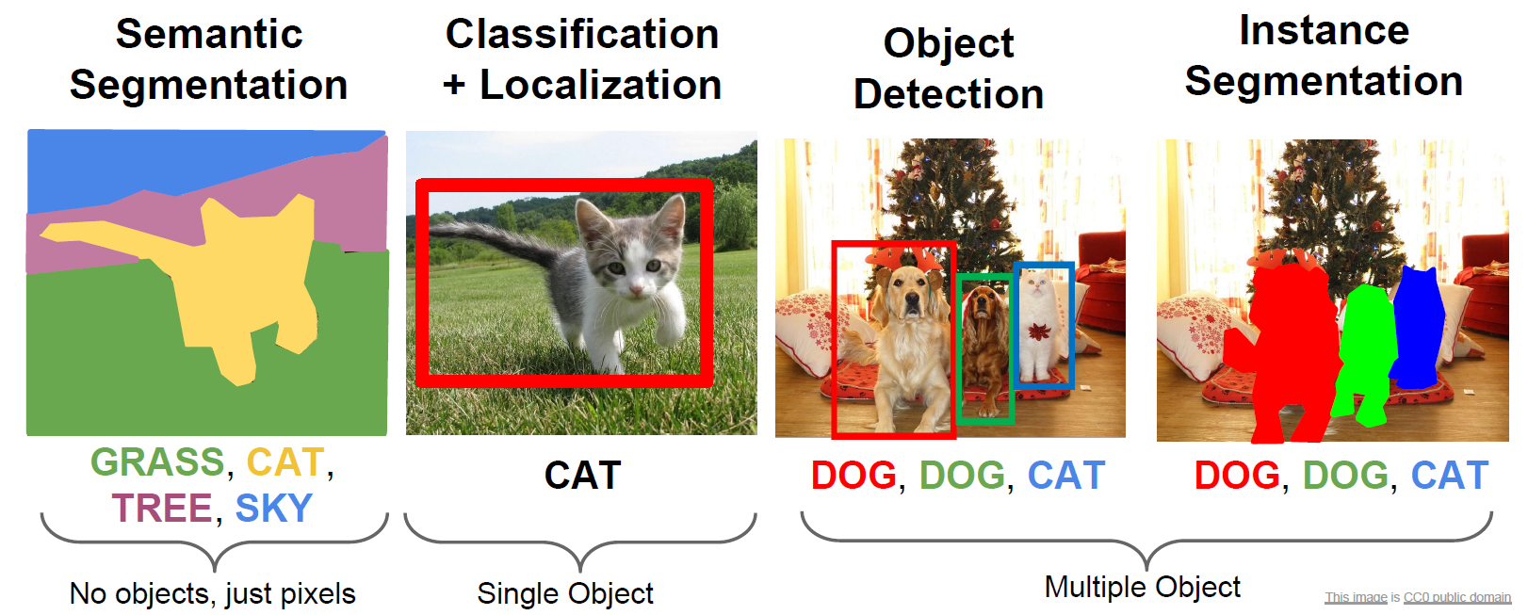
Computer Vision Task

Slide 3
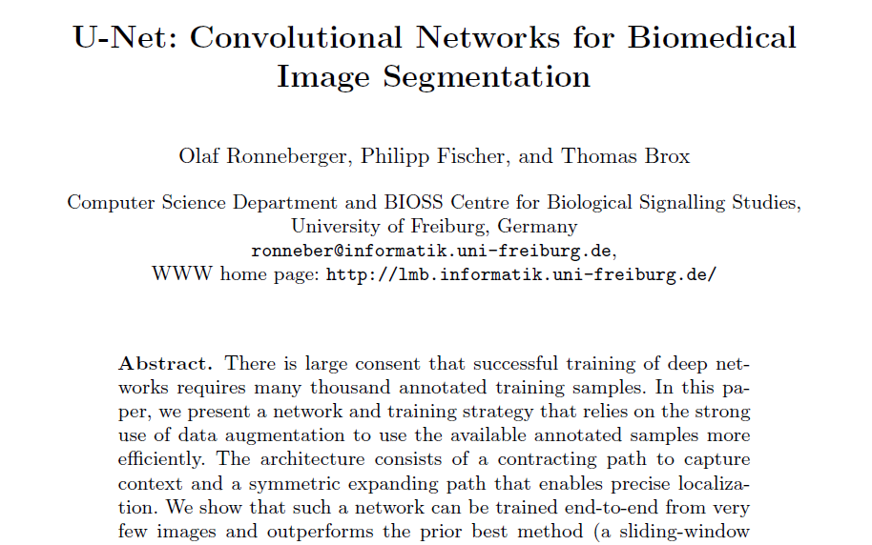
U-Net: Convolutional Networks for Biomedical Image Segmentation

Slide 4
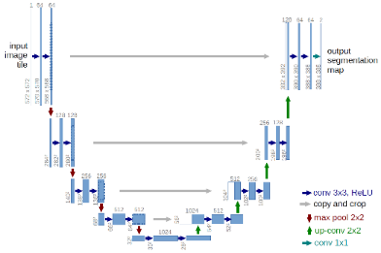
Biomedical Image Segmentation with U-net
U-Net
U-Net learns segmentation in an end-to-end setting
Very few annotated images (approx. 30 per application)

Slide 5
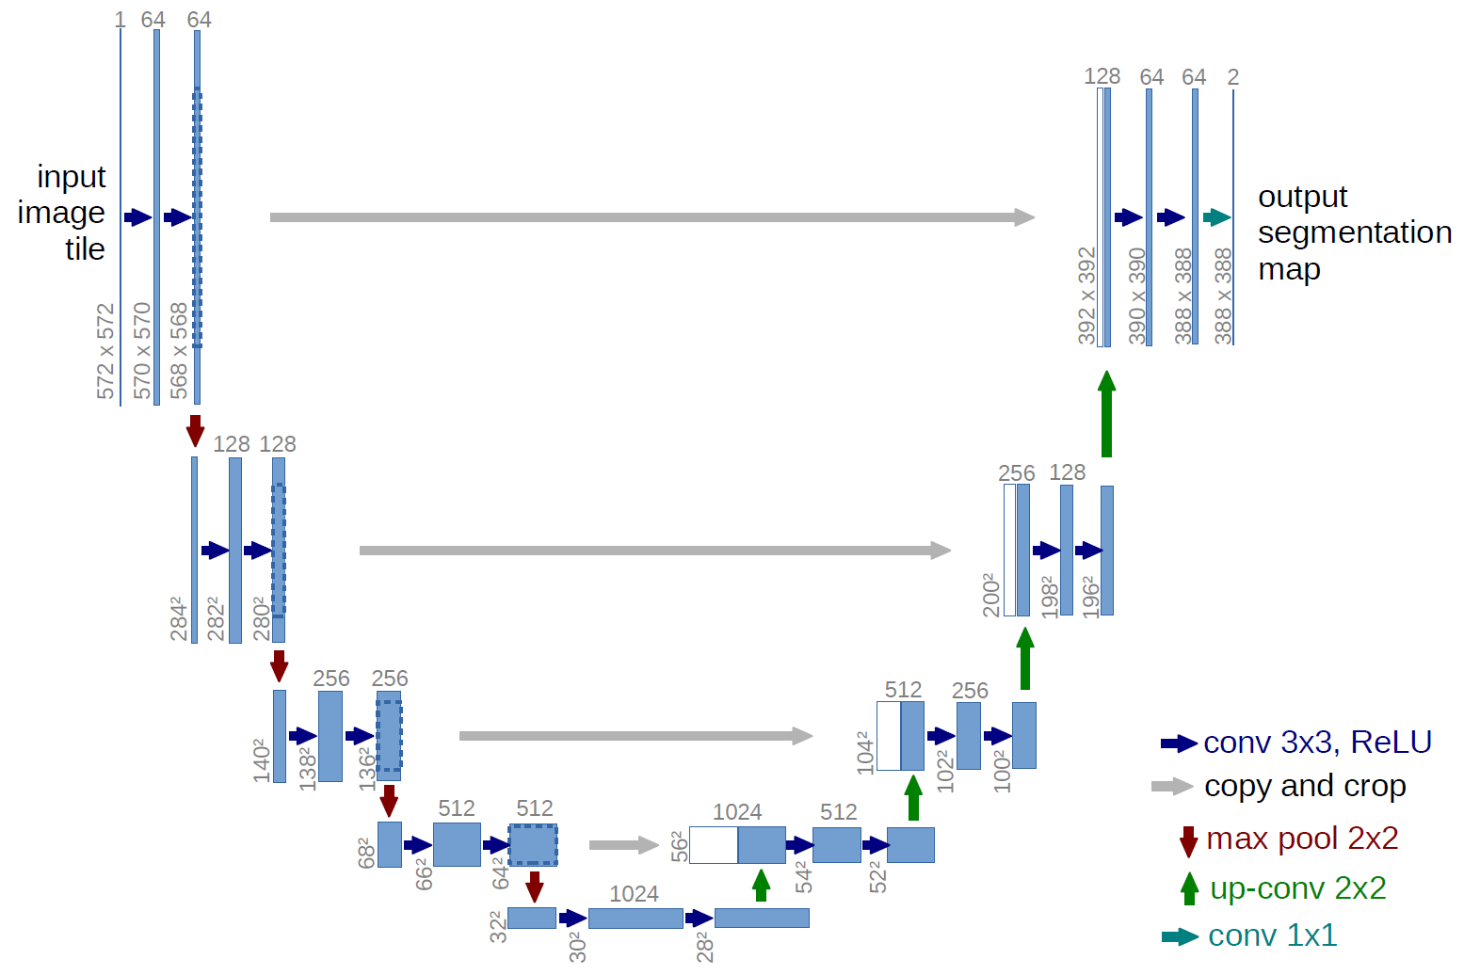
U-Net Architecture
# of channel
x-y size

Slide 6
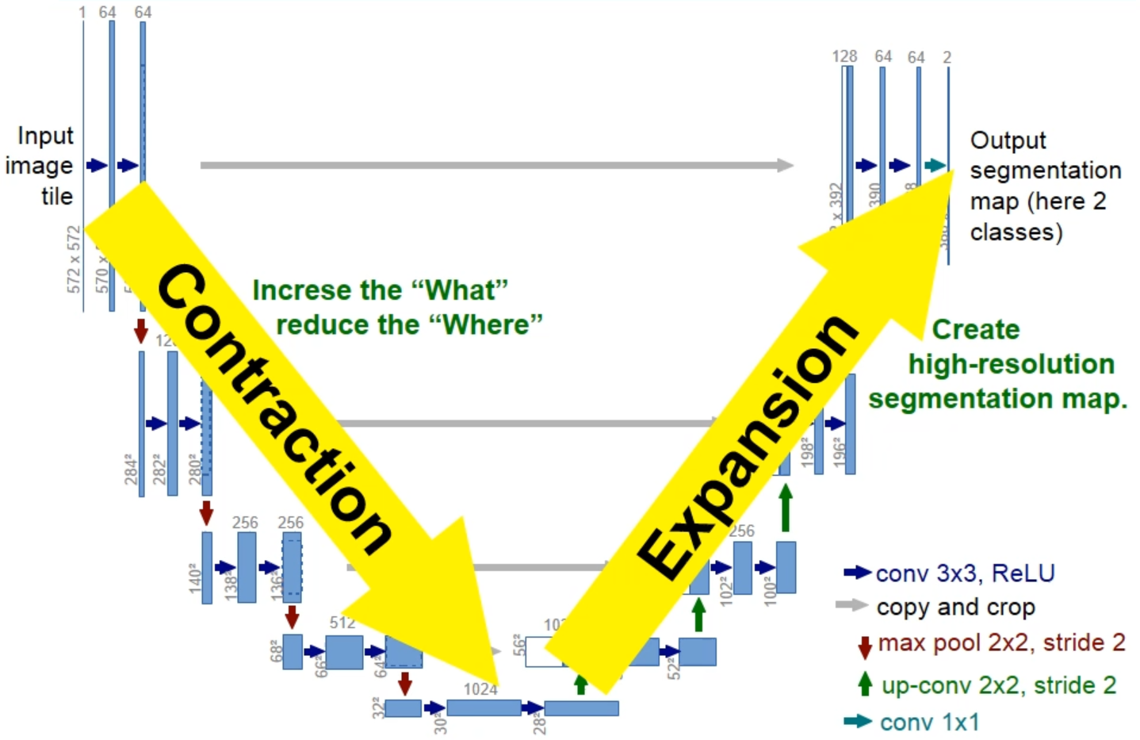
U-Net Architecture

Slide 7
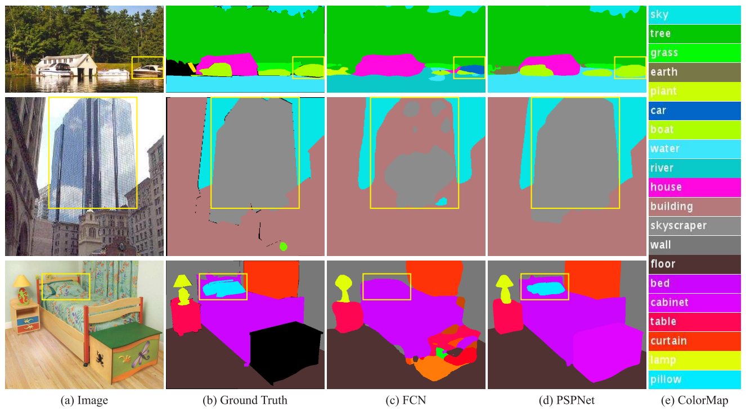
Context is Important

Slide 8
U-Net Architecture
# of channel
x-y size

Slide 9
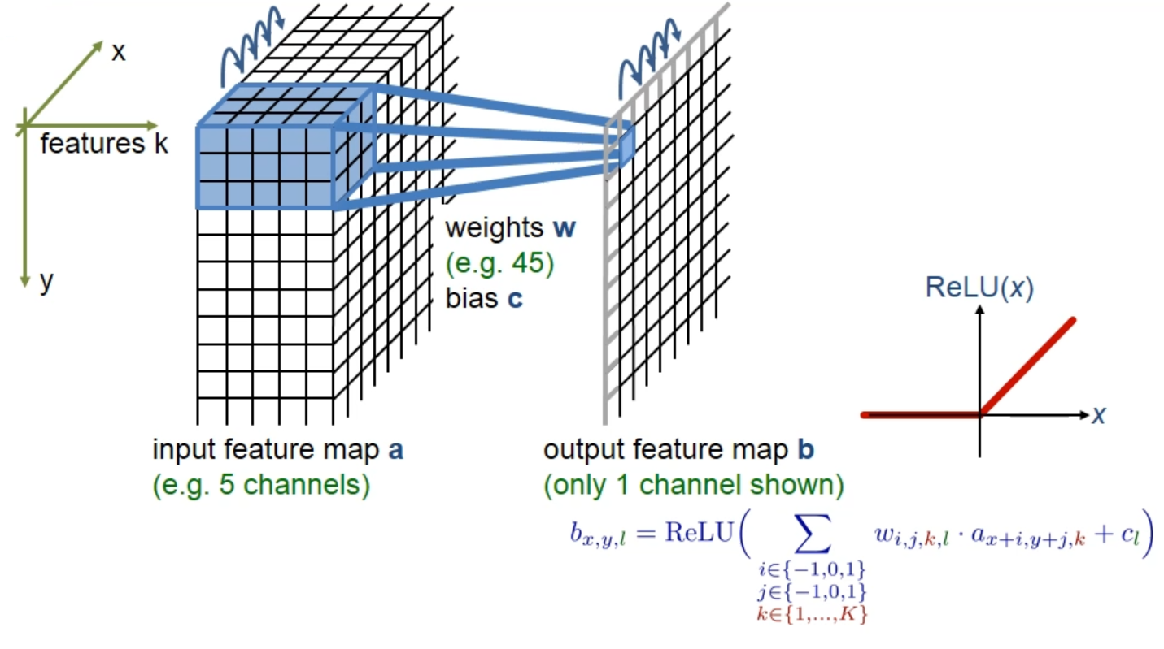
3x3 Convolution + ReLU

Slide 10
U-Net Architecture
# of channel
x-y size

Slide 11
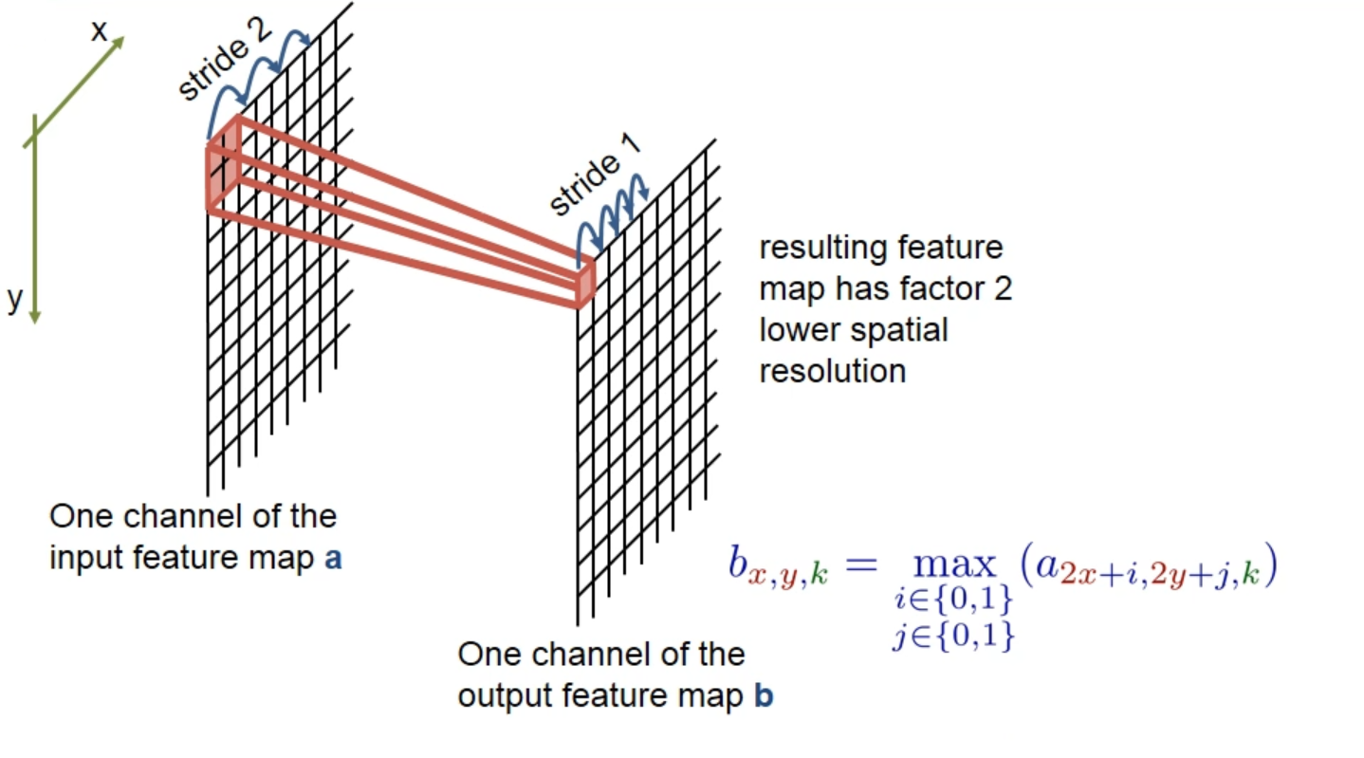
2x2 Max-pooling

Slide 12
U-Net Architecture
# of channel
x-y size
Cropping!

Slide 13
U-Net Architecture
# of channel
x-y size

Slide 14
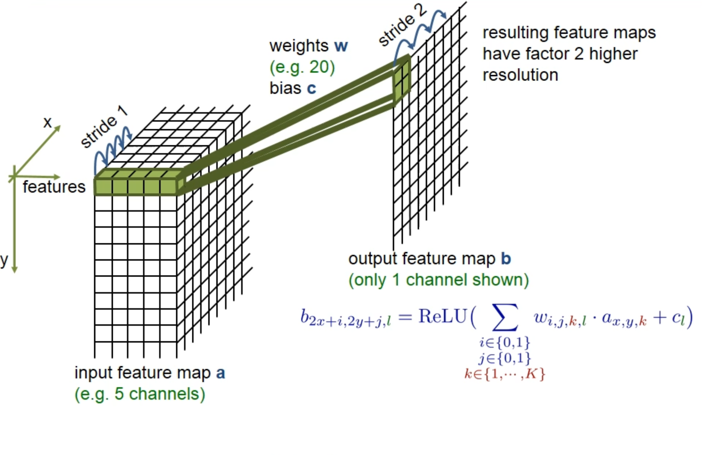
2x2 Up-convolution

